Slide 1
Appendix D Mapping Control to Hardware
Copyright © 2014 Elsevier Inc. All rights reserved.

Slide 2
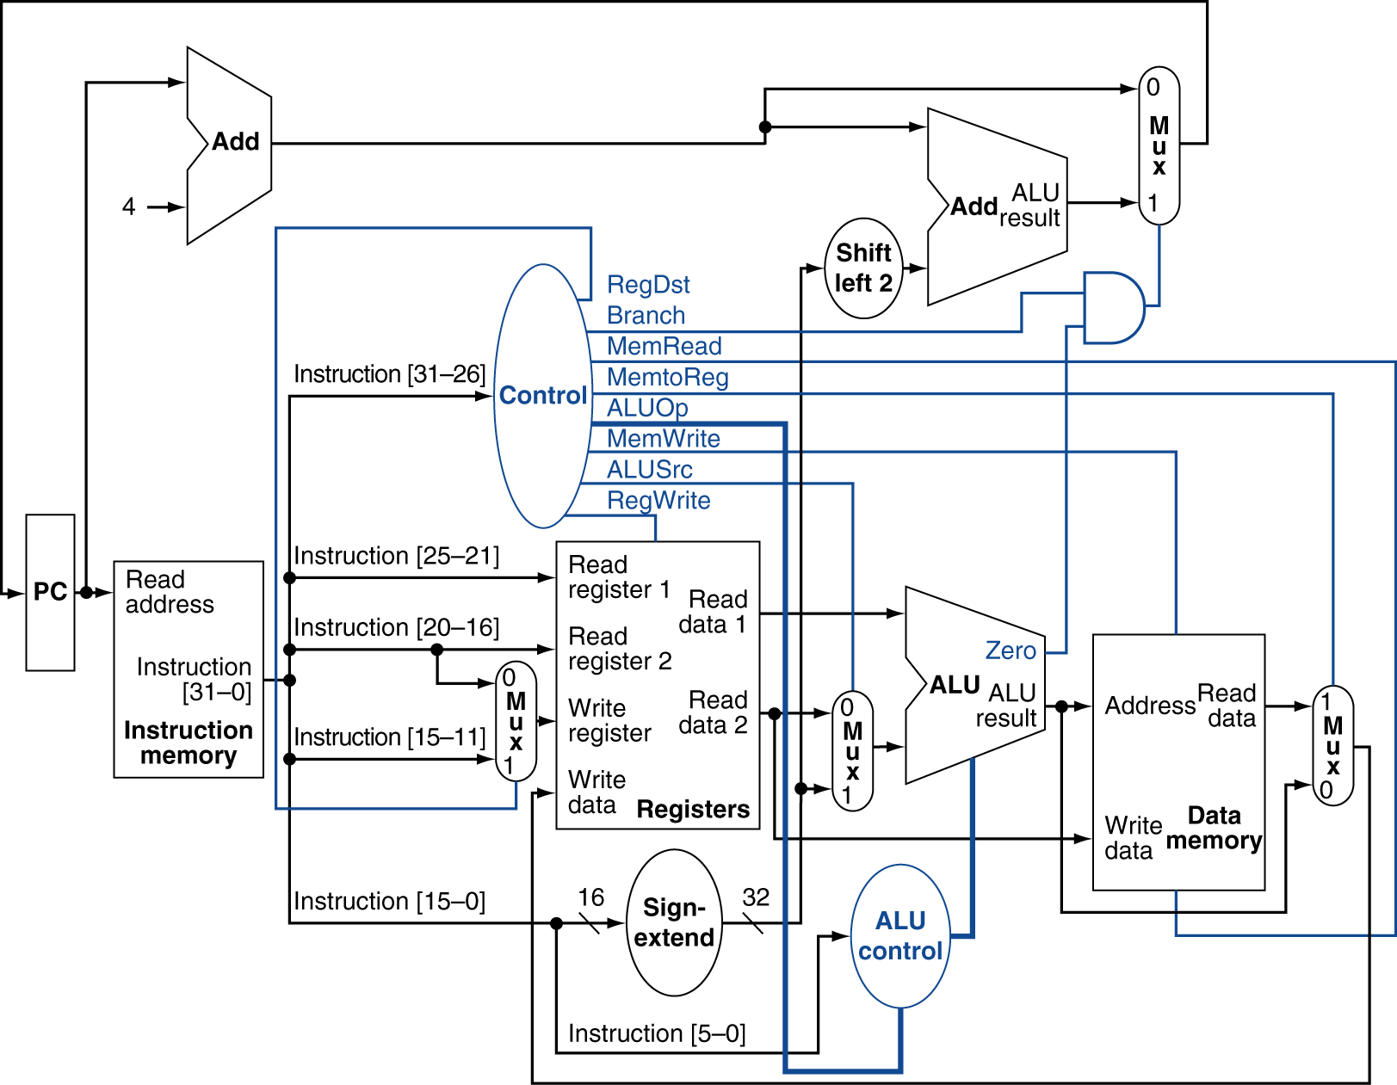
Datapath With Control
2
4
2

Slide 3
The Main Control Unit
Control signals derived from instruction
R-type
000000
rs
rt
rd
shamt
funct
31:26
25:21
20:16
15:11
10:6
5:0
Load
100011
rs
rt
address
31:26
25:21
20:16
15:0
Store
101011
rs
rt
address
31:26
25:21
20:16
15:0
Branch
000100
rs
rt
address
31:26
25:21
20:16
15:0

Slide 4
ALU Control
Assume 2-bit ALUOp derived from opcode
Combinational logic derives ALU control
opcode | ALUOp | Operation | funct | ALU function | ALU control
lw | 00 | load word | XXXXXX | add | 0010
sw | 00 | store word | XXXXXX | add | 0010
beq | 01 | branch equal | XXXXXX | subtract | 0110
R-type | 10 | add | 100000 | add | 0010
 |  | subtract | 100010 | subtract | 0110
 |  | AND | 100100 | AND | 0000
 |  | OR | 100101 | OR | 0001
 |  | set-on-less-than | 101010 | set-on-less-than | 0111

Slide 5
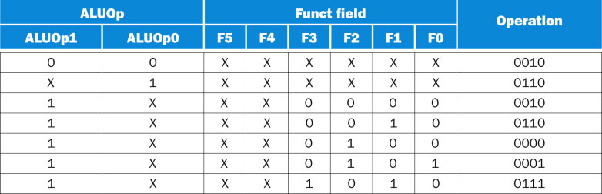
opcode | ALUOp | Operation | funct | ALU function | ALU control
lw | 00 | load word | XXXXXX | add | 0010
sw | 00 | store word | XXXXXX | add | 0010
beq | 01 | branch equal | XXXXXX | subtract | 0110
R-type | 10 | add | 100000 | add | 0010
 |  | subtract | 100010 | subtract | 0110
 |  | AND | 100100 | AND | 0000
 |  | OR | 100101 | OR | 0001
 |  | set-on-less-than | 101010 | set-on-less-than | 0111
Simplify
(2+6)-line input
4-line output
FIGURE D.2.1 The truth table for the 4 ALU control bits (called Operation) as a function of the ALUOp and function code field. This table is the same as that shown in Figure 4.13.
Copyright © 2014 Elsevier Inc. All rights reserved.

Slide 6
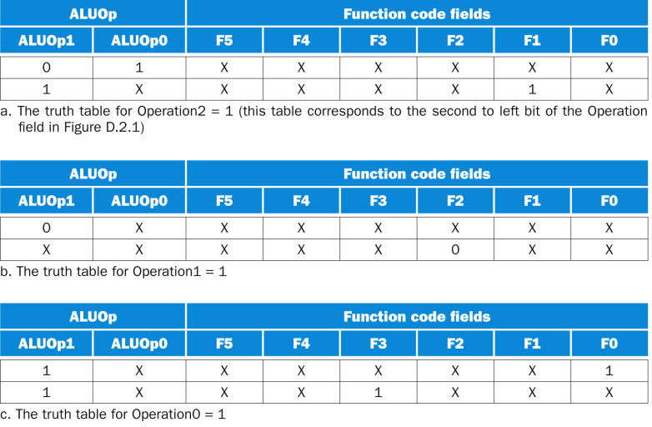
X
6
Copyright © 2014 Elsevier Inc. All rights reserved.

Slide 7
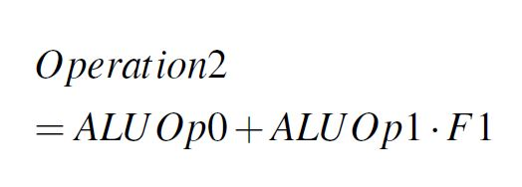
X
7
Copyright © 2014 Elsevier Inc. All rights reserved.

Slide 8
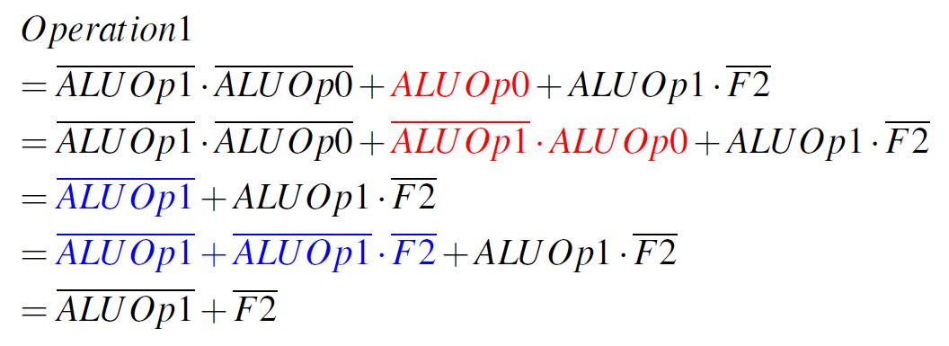
X
ALUOp0 = (ALUOp1 + ALUOp1) ALUOp0 = ALUOp1 ∙ ALUOp0 + ALUOp1 ∙ ALUOp0 = ALUOp1 ∙ ALUOp0
ALUOp1 = ALUOp1(1 + F2)
= ALUOp1 + ALUOp1∙ F2
Since ALUOp1 ALUOp0 = 11 is not input
8
Copyright © 2014 Elsevier Inc. All rights reserved.

Slide 9
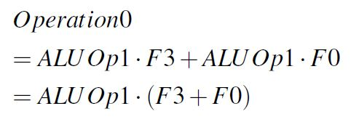
X
9
Copyright © 2014 Elsevier Inc. All rights reserved.

Slide 10
Datapath With Control
2
4
2

Slide 11
Datapath With Control
2
4
2

Slide 12
ALU Control
Input
ALU Control
Input
ALU Control
Output
opcode | ALUOp | Operation | funct | ALU function | ALU control
lw | 00 | load word | XXXXXX | add | 0010
sw | 00 | store word | XXXXXX | add | 0010
beq | 01 | branch equal | XXXXXX | subtract | 0110
R-type | 10 | add | 100000 | add | 0010
 |  | subtract | 100010 | subtract | 0110
 |  | AND | 100100 | AND | 0000
 |  | OR | 100101 | OR | 0001
 |  | set-on-less-than | 101010 | set-on-less-than | 0111
FIGURE D.2.1 The truth table for the 4 ALU control bits (called Operation) as a function of the ALUOp and function code field. This table is the same as that shown in Figure 4.13.
Copyright © 2014 Elsevier Inc. All rights reserved.

Slide 13
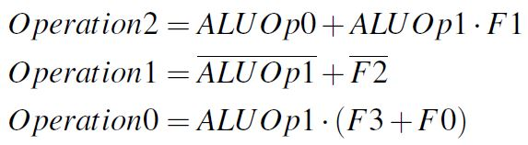
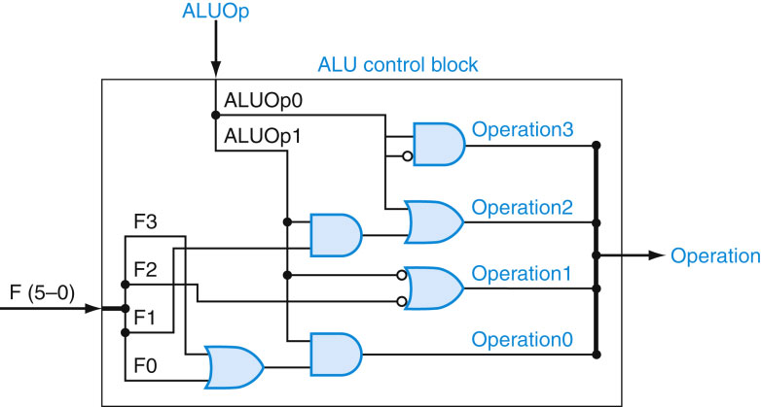
2
.
Always = 0
.
+
4
+
.
+
FIGURE D.2.3 The ALU control block generates the four ALU control bits, based on the function code and ALUOp bits. This logic is generated directly from the truth table in Figure D.2.2. Only four of the six bits in the function code are actually needed as inputs, since the upper two bits are alwa ys don’t cares. Let’s examine how this logic relates to the truth table of Figure D.2.2. Consider the Operation2 output, which is generated by two lines in the truth table for Operation2. The second line is the AND of two terms (F1 5 1 and ALUOp1 5 1); the top two-input AND gate corresponds to this term. The other term that causes Operation2 to be asserted is simply ALUOp0. These two terms are combined with an OR gate whose output is Operation2. The outputs Operation0 and Operation1 are derived in similar fashion from the truth table. Since Operation3 is always 0, we connect a signal and its complement as inputs to an AND gate to generate 0.
13
Copyright © 2014 Elsevier Inc. All rights reserved.

Slide 14
Datapath With Control
2
4
6
2

Slide 15
The Main Control Unit
Control signals derived from instruction
Load/ Store
35 or 43
rs
rt
address
31:26
25:21
20:16
15:0
Branch
4
rs
rt
address
31:26
25:21
20:16
15:0
R-type
0
rs
rt
rd
shamt
funct
31:26
25:21
20:16
15:11
10:6
5:0
35 = 100011
43 = 101011
4 = 000100
0 = 000000
ALUOp = 00
ALUOp = 00
ALUOp = 01
ALUOp = 10

Slide 16
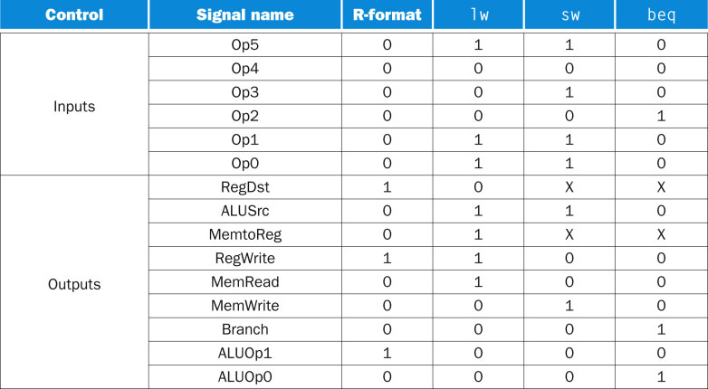
FIGURE D.2.4 The control function for the simple one-clock implementation is completely specified by this truth table. This table is the same as that shown in Figure 4.22.
16
Copyright © 2014 Elsevier Inc. All rights reserved.

Slide 17
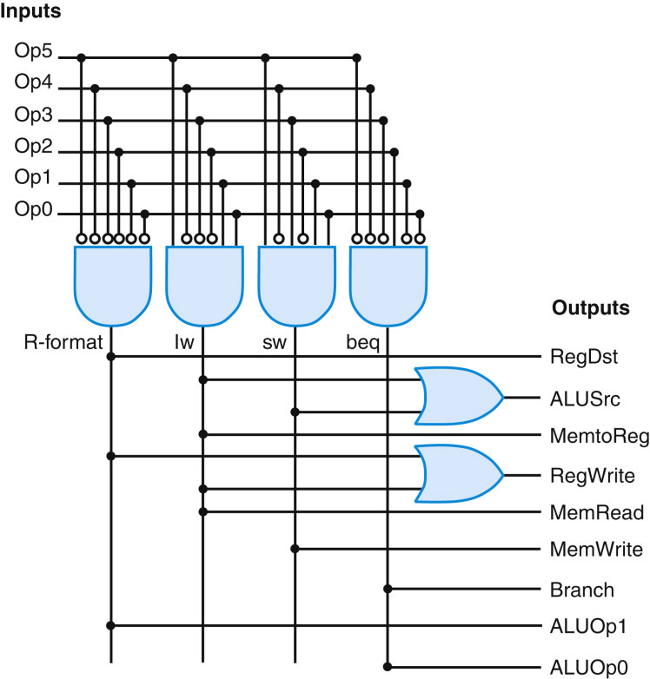
FIGURE D.2.5 The structured implementation of the control function as described by the truth table in Figure D.2.4. The structure, called a programmable logic array (PLA), uses an array of AND gates followed by an array of OR gates. The inputs to the AND gates are the function inputs and their inverses (bubbles indicate inversion of a signal). The inputs to the OR gates are the outputs of the AND gates (or, as a degenerate case, the function inputs and inverses). The output of the OR gates is the function outputs.
17
Copyright © 2014 Elsevier Inc. All rights reserved.

Slide 18
FIGURE D.2.5 The structured implementation of the control function as described by the truth table in Figure D.2.4. The structure, called a programmable logic array (PLA), uses an array of AND gates followed by an array of OR gates. The inputs to the AND gates are the function inputs and their inverses (bubbles indicate inversion of a signal). The inputs to the OR gates are the outputs of the AND gates (or, as a degenerate case, the function inputs and inverses). The output of the OR gates is the function outputs.
18
Copyright © 2014 Elsevier Inc. All rights reserved.

Slide 19
Datapath With Control
4
2

